Slide 1
Program 4
Mickey Ma (马毓琦): mickeyma@cuhk.edu.cn
Office: Teaching C Building Room 402(TC-402)
Phone: 0755-23519635

Slide 2
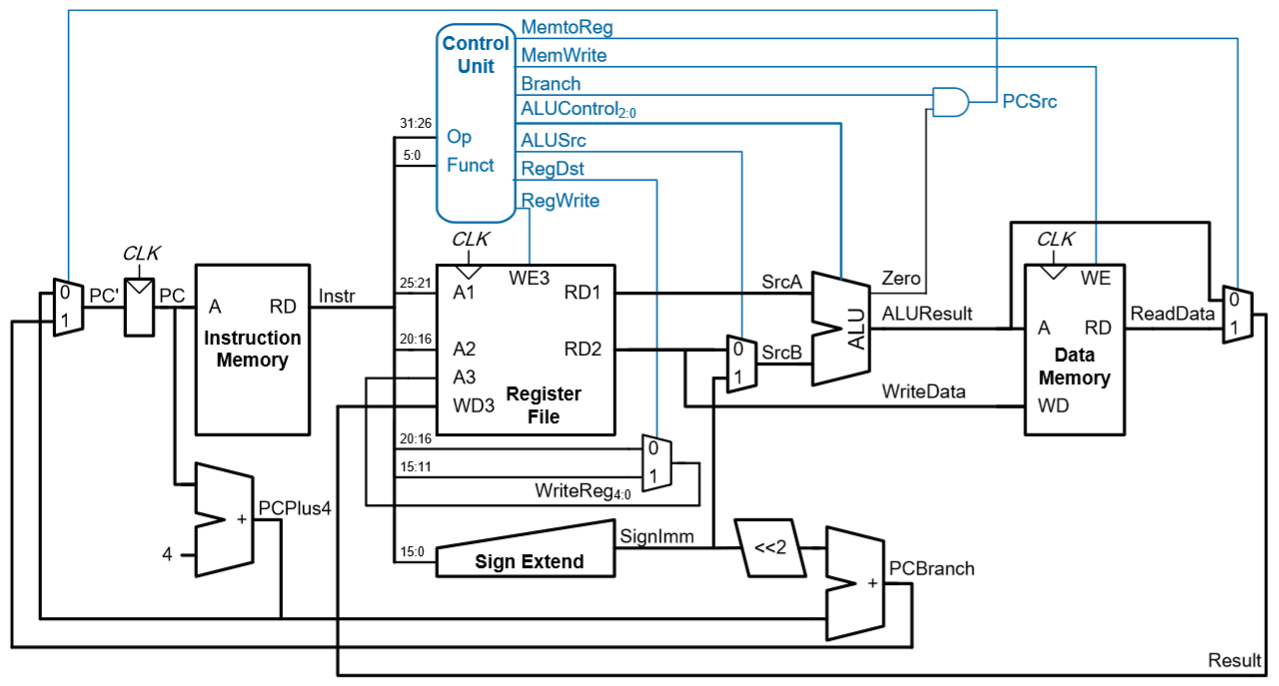
Single-cycle MIPS Processor

Slide 3
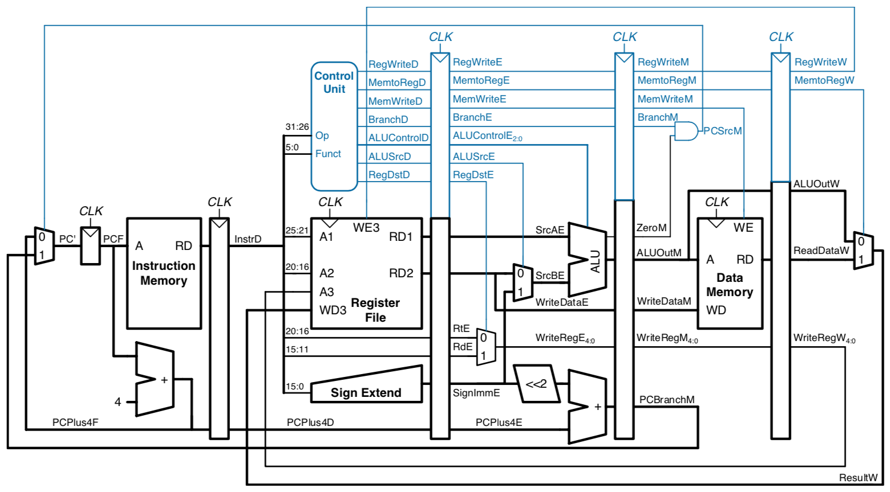
Pipelined Processor with Control

Slide 4
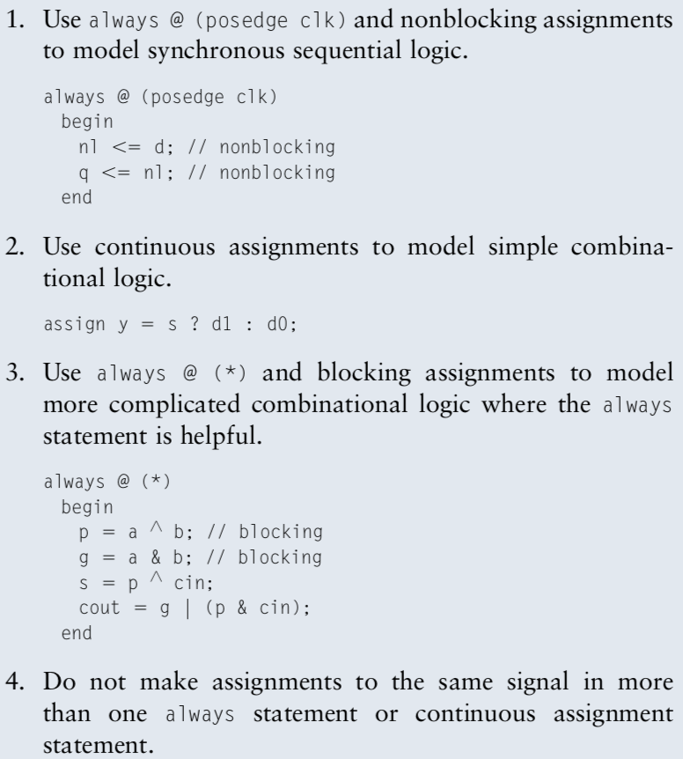
Blocking and non-blocking assignments
Example:
a = 1; b = 2; c = 0;
1.
always @ (*)
begin
b <= a;
c <= b;
end
end
//We will get b = 1, c = 2
2.
always @ (*)
begin
b = a;
c = b;
end
end
//We will get b = 1, c = 1

Slide 5
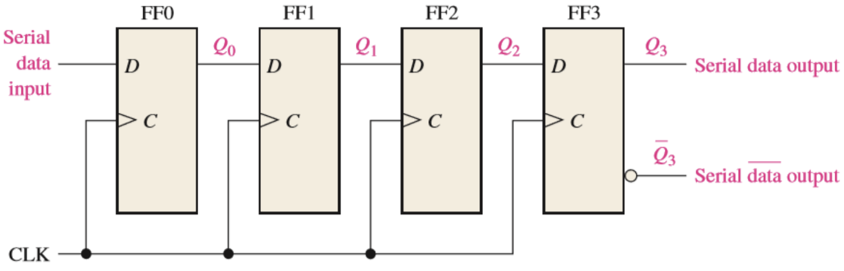
Example: Shift register

Slide 6
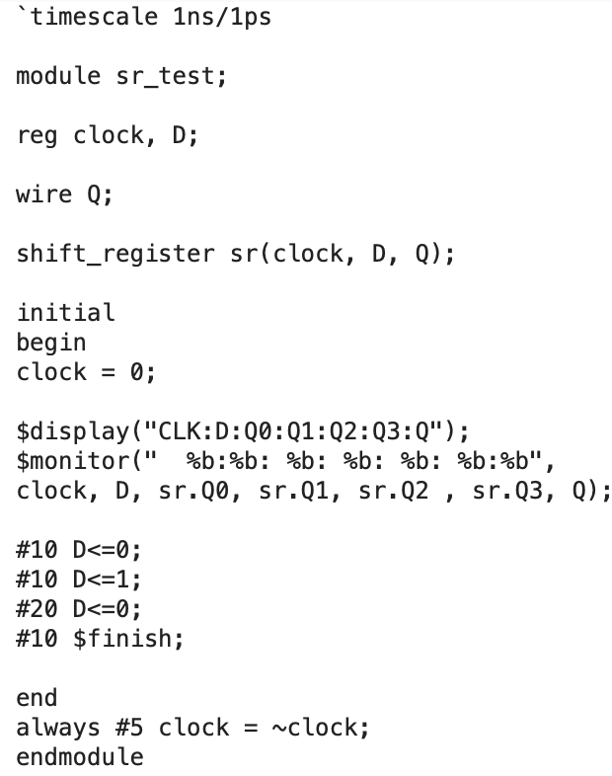
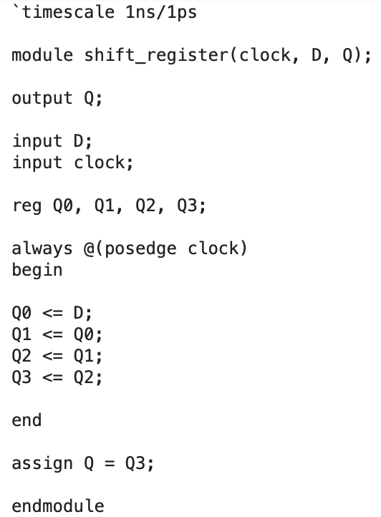

Slide 7
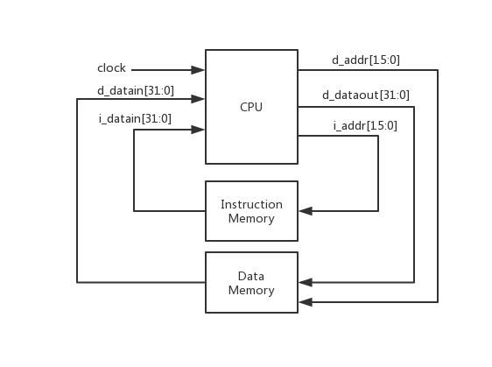
Top View

Slide 8
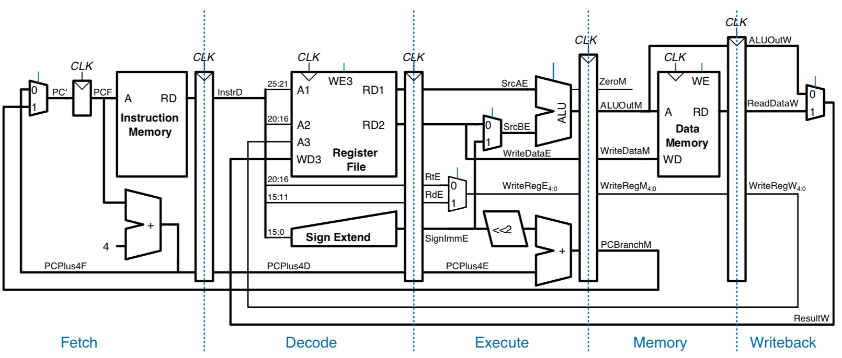
Pipelined Datapath

